Slide 1
Welcome to Yew Class
2026-2027

Slide 2
Teaching Staff
Mr Bond
Mr Davis
Mrs Andrews
Miss Guildford
Mrs Mitchell

Slide 3
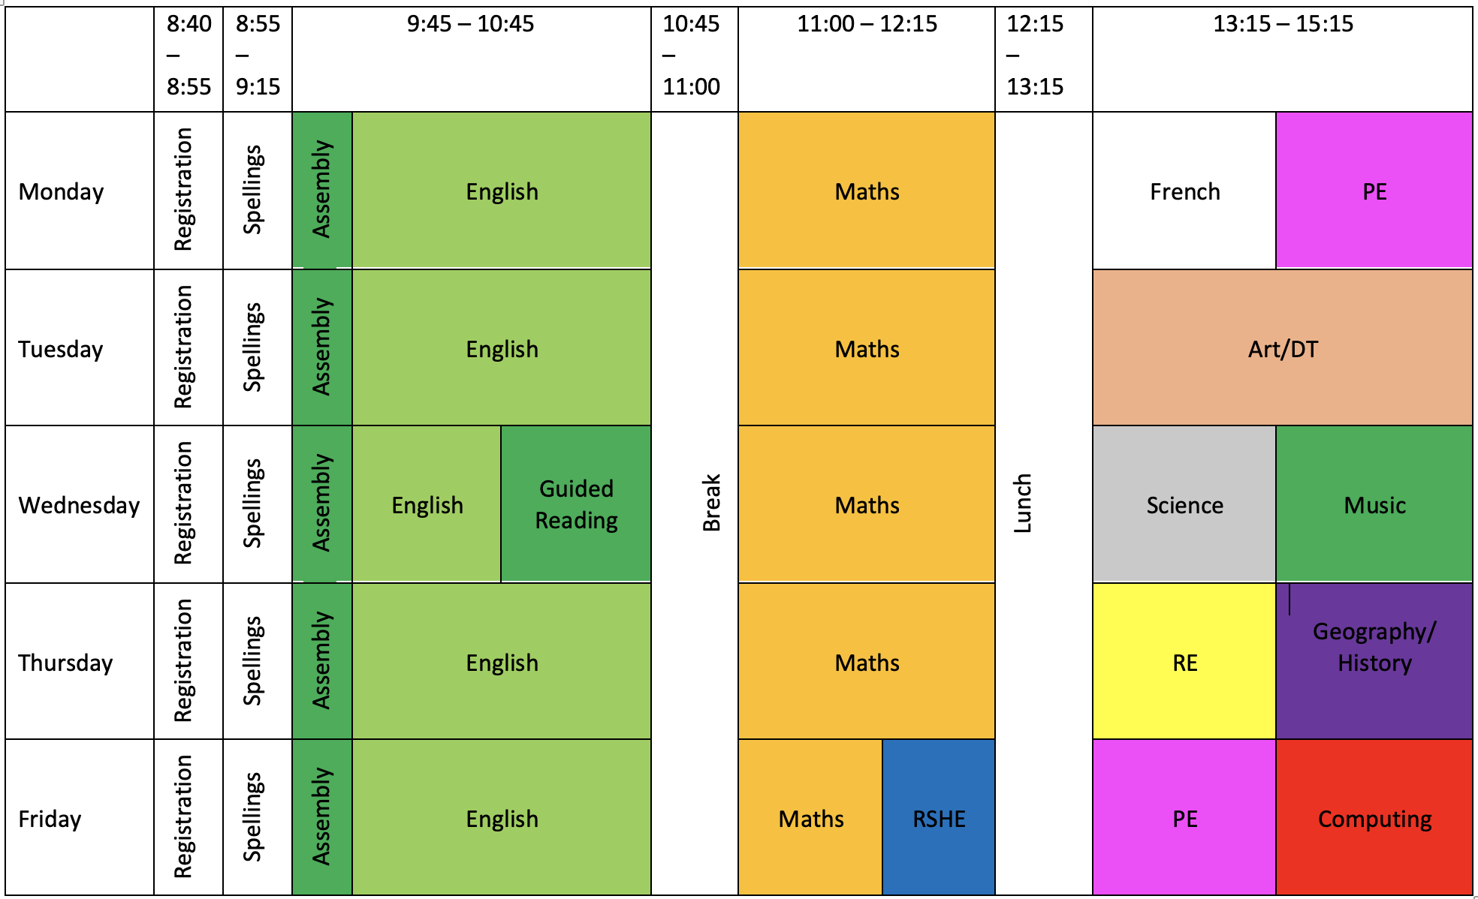
Timetable

Slide 4
Routines
Homework
  5 CGP Homework Books in on a Thursday at the latest and back out on a Friday (if help is given, please put an S in the top corner)
  Guided Reading Questions in on a Wednesday
  Spellings, tested on a Monday – new ones out on a Monday to be practiced on the sheet.
PE Kit (needed for a Monday and Friday – yellow school t-shirt, green jumper, black tracksuit bottoms, black shorts/skirt and trainers).
Forest school the second Autumn half term on Tuesdays.
Things to bring into class – water bottles and snack pots. Children are more than welcome to bring pencil cases from home, we do have everything they will need, so you don’t need to provide anything.
School Website has all the information for homework and upcoming events.

Slide 5
Reading
Hopefully all your children have brought home their reading record with a book.
Reading records will be collected in every 2 weeks just to keep tabs on how much we are reading and more importantly what we are reading.

Slide 6
Dates
SATs and Residential meeting: April 2027
Bikeability 3 groups: 30th September/1st October, 6th/7th, 19th/20th October (adult helpers required for the course to run)
KS2 Test Week: 10th May (All one week)
Transition Days: 29th and 30th June
Year 6 performance: 6th and 7th July
Residential: 12th – 14th July
Leavers Service: 21st July

Slide 7
Residential
Kilve Court – first time for all of us.
Outdoor activities – they have the potential for water based activities as well as climbing, cycling and high ropes.
https://sseoutdoors.co.uk/centres/kilve-court/

Slide 8
KS2 Test Week
10th May
No Writing or Science paper.
English spelling test.
English grammar and punctuation test.
English reading.
Mathematics (3 papers – arithmetic, reasoning 1 and reasoning 2).
Teacher Assessment for writing

Slide 9
KS2 Test Information
Children will receive 3 scores:
  Working at National Expectation – Yes/No.
  Scaled Score – 100 is expected.
  Raw Score

Slide 10
What can you do?
Reading - this is the most important thing you can do
Times Tables – through ttrockstars
Spelling – regular engagement in their spellings
Interact with them about Homework
Check the website – https://www.trullprimary.com/page/?title=Yew&pid=134
Internet Sites – MyMaths, BBC Bitesize, etc.
Talk to them about their learning

Slide 11
Secondary School
Castle School – open morning –18th, 22nd , 24th Sept. Open evening 16th Sept
Bishops Foxes – open morning – 22nd and 25th Sept Open evening 17th Sept
Kingsmead – Open evening 1st Oct
Monkton Wood - Open evening 10th Sept
Pyrland School – dates to be released.
Please see individual school websites for further information.

Slide 12

Online Safety information
Using the TEAM approach can help to keep children safe.

Slide 13
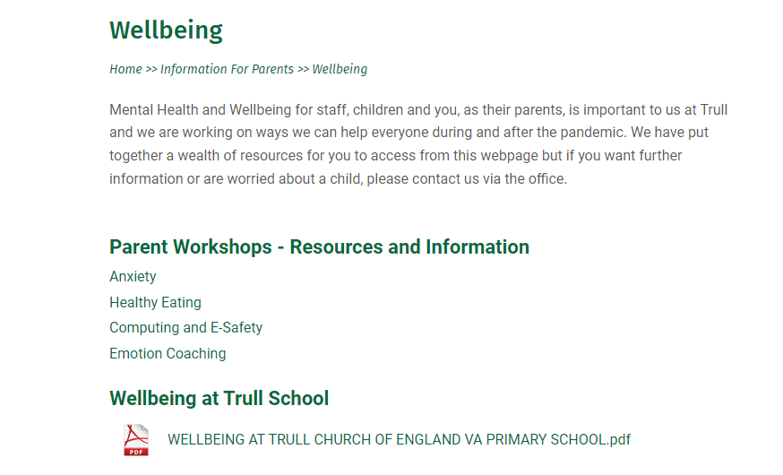
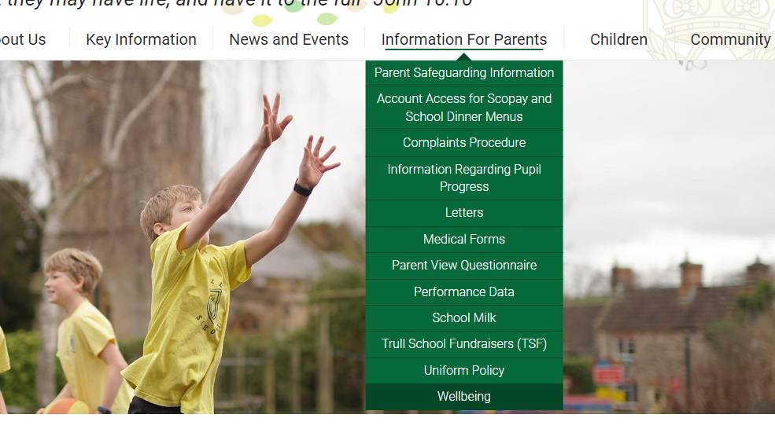
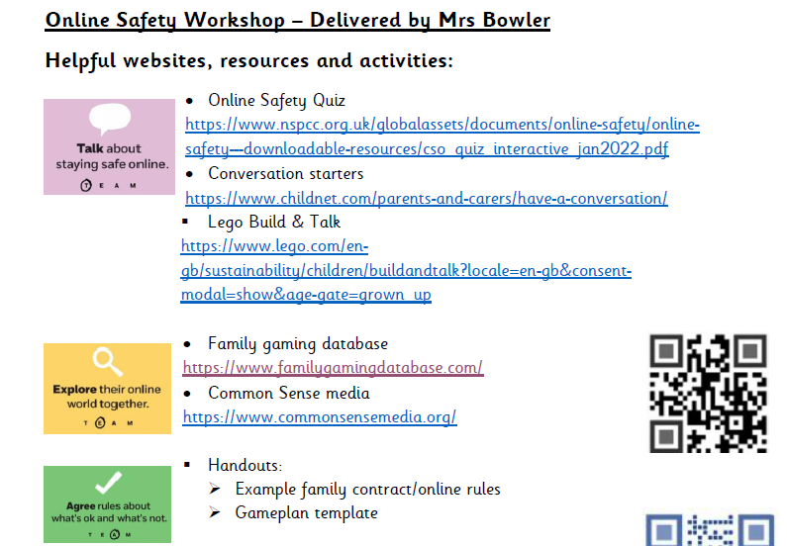
Please visit our school website to find helpful resources to support you with online safety at home: https://www.trullprimary.com/
Click on the Wellbeing page to find the resources

Slide 14
Any Questions?
If you have any questions throughout please use the school or class email, come and see me on the door or ring the school office and they or I will get back to you.
Class email address: Yew.Class@trullschool.co.uk

