Slide 1
Year 6 SATs and Residential 2026

Slide 2
What are the SATs?
SATs are the Standardised Assessment Tests that are given to children at the end of Key Stage 2.
The SATs take place over four days, starting on Monday 11th May ending on Thursday 14th May.
The SATs papers consist of:
  Spelling, punctuation and grammar (paper 1: Grammar/ Punctuation/ Spelling) – Monday 11th May
  Spelling, punctuation and grammar (paper 2: Spelling test) – Monday 11th May
  Reading – Tuesday 12th May
  Maths (paper 1: Arithmetic) – Wednesday 13th May
  Maths (paper 2: Reasoning) – Wednesday 13th May
  Maths (paper 3: Reasoning) – Thursday 14th May
Writing is assessed using evidence collected throughout Year 6. There is no Year 6 SATs writing test.
The key stage 2 tests will be taken on set dates unless your child is absent, in which case they may be able to take them up to 5 school days afterwards.
Notes:
Note that there are no science assessments this academic year (including sampling tests).

Slide 3
When and how the SATs are completed
The tests take place during normal school hours, under exam conditions.
Children are not allowed to talk to each other from the moment the assessments are handed out until they are collected at the end of the test.
After the tests are completed, the papers are sent away to be marked externally.
The results are then sent to the school in July.
Each test lasts no longer than 60 minutes:
  Spelling, punctuation and grammar (paper 1: Grammar/ Punctuation) – 45 minutes
  Spelling, punctuation and grammar (paper 2: Spelling) – 15 minutes
  Reading – 60 minutes
  Maths (paper 1: Arithmetic) – 30 minutes
  Maths (paper 2: Reasoning) – 40 minutes
  Maths (paper 3: Reasoning) – 40 minutes

Slide 4
The results
Tests are marked externally. Once marked, the tests will be given the following scores:
A raw score (total number of marks achieved for each paper);
A scaled score (see below);
A judgement on if the National Standard has been met.
After marking each test, the external marker will convert the raw score to a scaled score. Even though the tests are made to the same standard each year, the questions must be different. This means the difficulty of the tests may vary. Scaled scores ensures an accurate comparison of performance over time.
Scaled scores range from 80 to 120.
A scaled score of 100 or more shows the pupil is meeting the National Standard.
Notes:
There is no separate test that would indicate a pupil is working above the national standard.
A scaled score of less than 99 would indicate a pupil is working below the national standard.
To have a scaled score, pupils must have a minimum raw score (determined each year). If the pupil does not achieve the minimum raw score, they have not demonstrated sufficient understanding of the KS2 curriculum in the subject.

Slide 5
Spelling, Punctuation and Grammar: Monday 11th May
Spelling, Punctuation and Grammar consists of two papers.
Paper 1 focuses on all three elements (spelling, punctuation and grammar). The paper lasts for 45 minutes.
Paper 2 consists of a spelling test only. It should take approximately 15 minutes, although this is not a set amount of time (pupils should be given as much time as they need to complete the test).

Slide 6
Spelling, Punctuation and Grammar: Paper 1
The children will have been working hard with their class teacher on developing and securing their knowledge of the technical vocabulary needed in this test.
This test focuses on:
Grammatical terms/ word classes;
Functions of sentences;
Combining words, phrases and clauses;
Verb forms, tenses and consistency;
Punctuation;
Vocabulary;
Standard English and formality.
This test requires a range of answer types but does not require longer formal answers.
Notes:
The question types include:
Circling
Drawing lines to connect
Multiple choice questions (including ticking tables)
One-word answers
Short answer questions

Slide 7
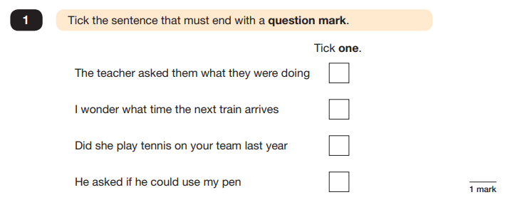
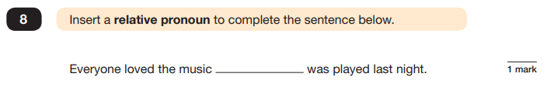
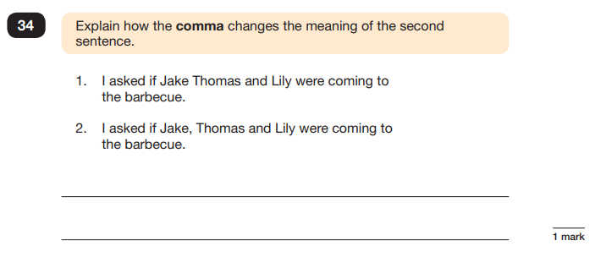
Spelling, Punctuation and Grammar: Paper 1
Example questions:
e.g. that, which
✓
e.g. The first sentence is about two people and the second sentence is about three people.
Notes:
For questions 8 and 34, there are various correct answers.

Slide 8
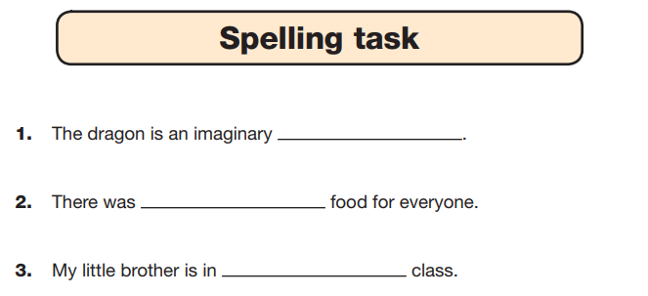
Spelling, Punctuation and Grammar: Paper 2
Paper 2 is a shorter paper that focuses solely on spellings.
Example questions:
Notes:
There is a spelling script that accompanies this. Example:
The word is creature. The dragon is an imaginary creature. The word is creature.

Slide 9
Reading: Tuesday 12th May
There is one reading test that lasts for 60 minutes.
The test is designed to measure if the children’s comprehension of age-appropriate reading material meets the national standard. There are three different set texts for children to read. These could be any combination of non-fiction, fiction and/ or poetry.
The test covers the following areas (known as Content Domains):
Give/ explain the meaning of words in context;
Retrieve and record information/ identify key details from fiction and non-fiction;
Summarise main ideas from more than one paragraph;
Make inferences from the text/ explain and justify inferences with evidence from the text;
Predict what might happen from details stated and implied;
Identify/ explain how information/ narrative content is related and contributes to meaning as a whole;
Identify/ explain how meaning is enhanced through choice of words and phrases;
Make comparisons within the text.

Slide 10
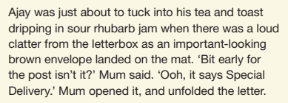
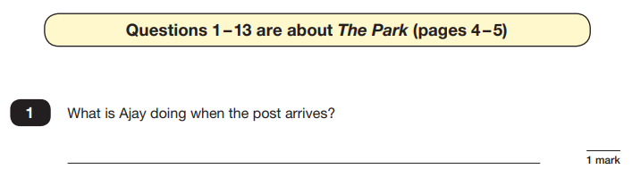
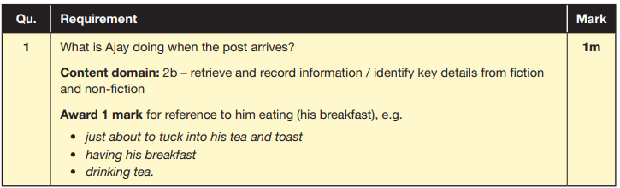
Reading
The reading SATs paper requires a range of answer styles.
Example questions:
Notes:
Question styles include:
Multiple choice questions
One-word answers
Short answer questions
Multiple mark (long answer) questions

Slide 11
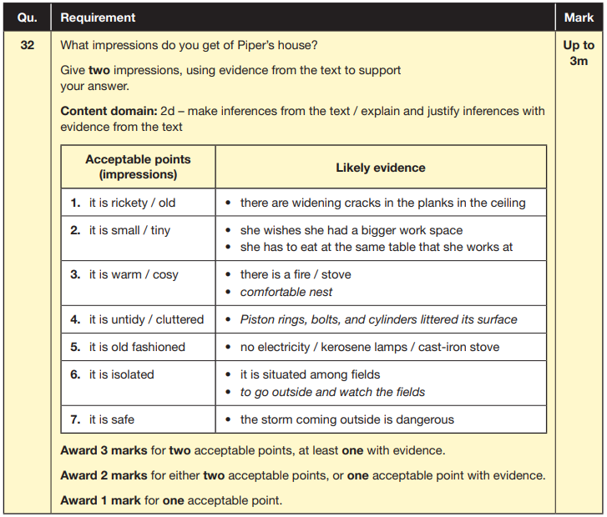
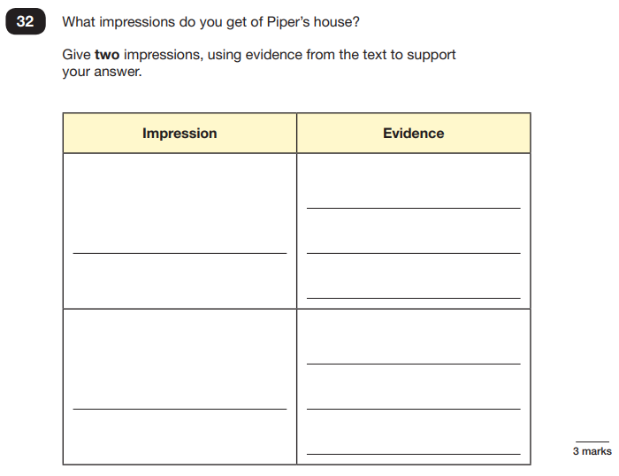
Reading
Example questions:
Based on text 3: Music Box
Notes:
This question is based on the whole text (2 pages).

Slide 12
Maths: Wednesday 13th May and Thursday 14th May
The maths assessments consist of three tests.
Paper 1: Arithmetic (30 minutes) – Wednesday 13th May
Paper 2: Reasoning (40 minutes) – Wednesday 13th May
Paper 3: Reasoning (40 minutes) – Thursday 14th May

Slide 13
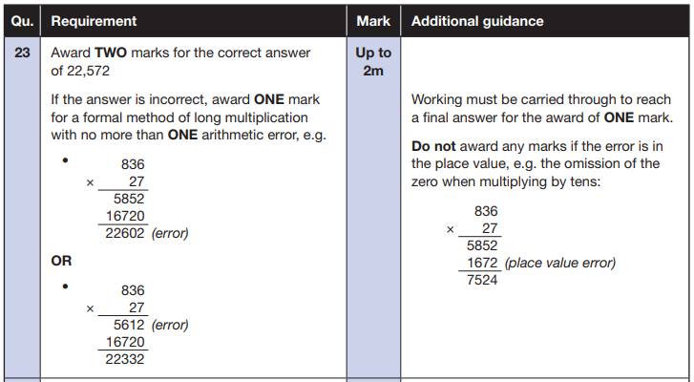
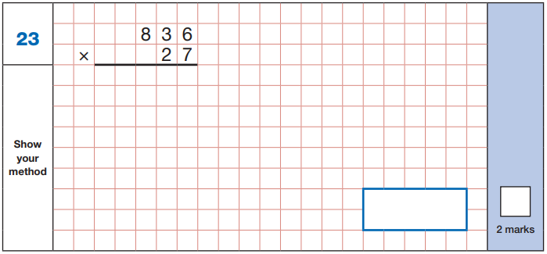
Maths Paper 1 (Arithmetic)
The maths arithmetic paper has a total of 40 marks.
The test covers the four operations (addition, subtraction, multiplication, division, including order of operations requiring BODMAS), percentages of amounts and calculating with decimals and fractions.
Example question:
Notes:
Identify that there are some questions that have 2 marks and some that have 1. If the answer to this question is wrong, children could still get a mark for a correct method containing an error.

Slide 14
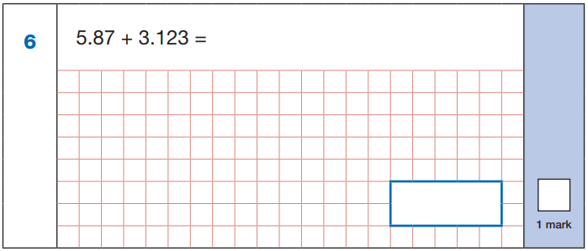
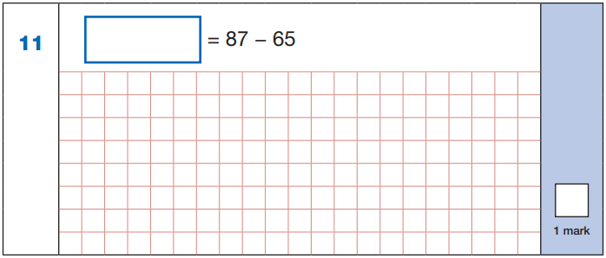

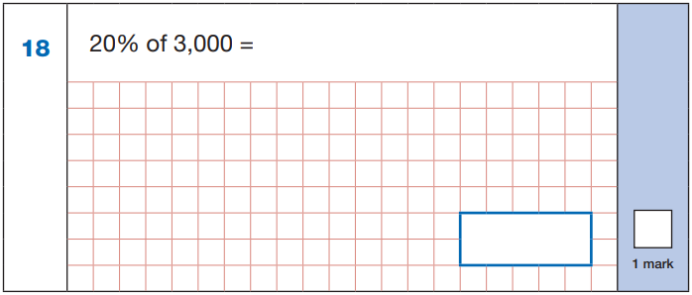
Maths Paper 1 (Arithmetic)
Example questions:
22
5.87
+ 3.123
8.993
87
- 65
22
8.993
60 ÷ (30 - 24)
60 ÷ 6 = 10
10% of 3,000 = 300
20% of 3,000 = 600
10
600
Notes:
These are examples of how children could solve the calculations. There are some that could/ should be solved mentally as it is far quicker that way (40 marks in 30 minutes does not allow for 1 minute + per mark).
Answers should always be given in their simplest form unless stated otherwise (e.g. for question 11, 20 + 2 would not be accepted as a correct answer).

Slide 15
Maths Papers 2 and 3 (Reasoning)
Paper 2 will take place on Wednesday 13th May and paper 3 will take place on Thursday 14th May. These tests have a total of 35 marks each.
These papers require children to demonstrate their mathematical knowledge and skills, as well as their ability to solve problems and their mathematical reasoning. They cover a wide range of mathematical topics from key stage 2 including,
Number and place value (including Roman numerals);
The four operations;
Geometry (properties of shape, position and direction);
Statistics;
Measurement (length, perimeter, mass, volume, time, money);
Algebra;
Ratio and proportion;
Fractions, decimals and percentages.
Notes:
In general, the questions get progressively harder throughout the paper. As this is the case, it is not unusual for children to be unable to complete the entire paper in the given time. Maths Paper 1 (Arithmetic)

Slide 16
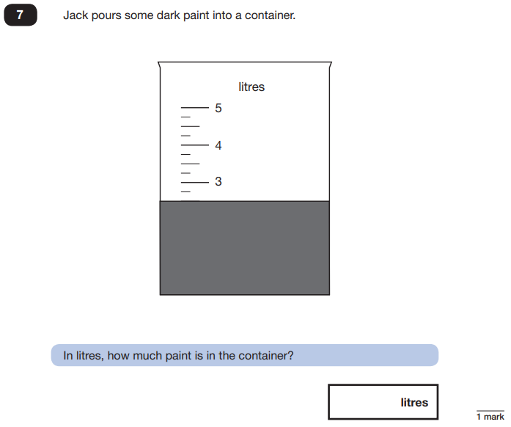
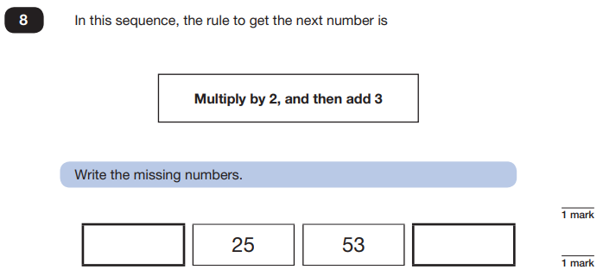
Maths Papers 2 (Reasoning)
Example questions:
11
109
2.5 or 2 ½

Slide 17
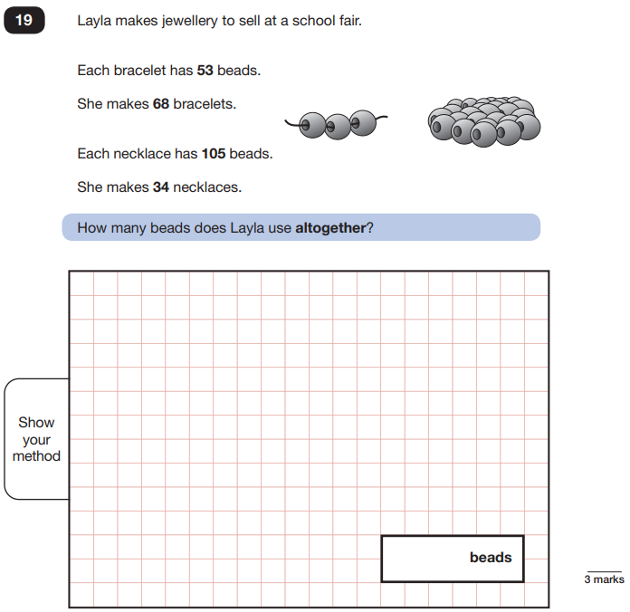
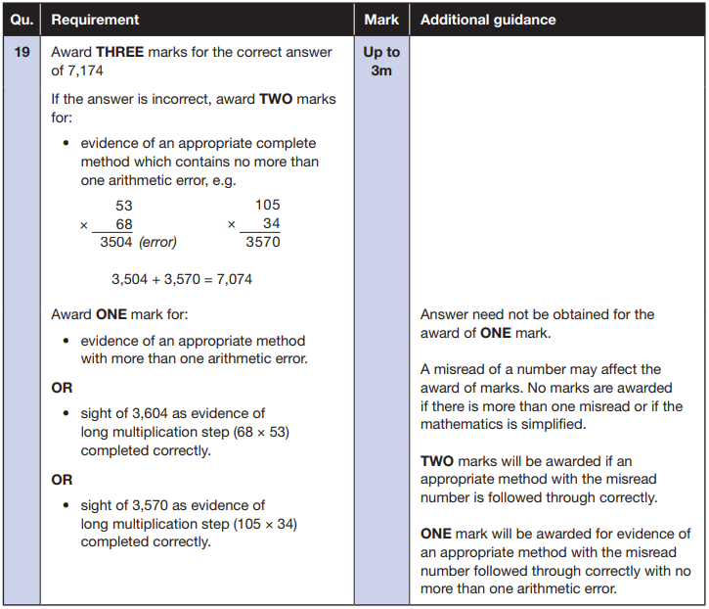
Maths Papers 3 (Reasoning)
Example question:
Notes:
Note that this is a three mark question.

Slide 18
Supporting your child
Tips:
Practice – Mymaths and spelling shed are great resources as is BBC Bitesize.
Keep revision light. Going over key skills (times tables, real world mental maths as you are shopping or cooking).
Ensure your child is eating and drinking well and getting a good amount of sleep – from experience they will be really tired by the end of each day.
Read with them as often as you can.
Talk to us, if they are incredibly anxious they shouldn’t be, its about them doing their best and showing what they are good at.
Notes:
Encourage parents not to use past papers at home. If they want to use past papers with tutors, suggest that they could take copies of completed test home to work through with tutors. This may help them to work through specific misunderstandings.

Slide 19
Advice for Year 6 children
Listen to your teacher.
The adults you work with all want you to do your best.
Get plenty of sleep and eat well, this will help your brain.
Read all the questions carefully. This can help you to avoid silly mistakes.
Don’t panic. There may be questions you think you can’t answer. Take a deep breath. Read it again. You can always move on and go back to it later. It’s often better to write something rather than nothing.
Remember that the Year 6 SATs last for 4 days out of your whole life!

Slide 20
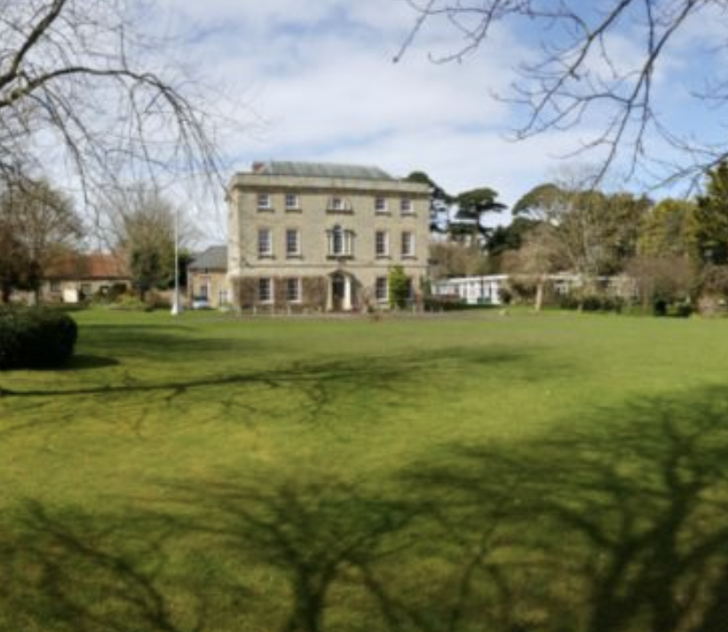
Residential – 13th to 15th July
Kilve Court
https://sseoutdoors.co.uk/centres/kilve-court/
We will be leaving school at 10:15 on the Monday morning children arrive at the normal time – with their one SMALL bag 🤞 and a back pack.
We will arrive back at 2:30 on the Wednesday afternoon – so children can be picked up as normal.
Children will need a packed lunch for the Monday – can this be in something that can be recycled to thrown away.

Slide 21
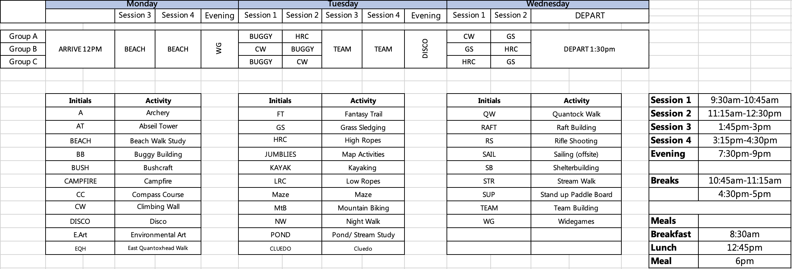
Activities
We will receive our final timetable 2 weeks before but below is last years activities and how the day was built.

Slide 22
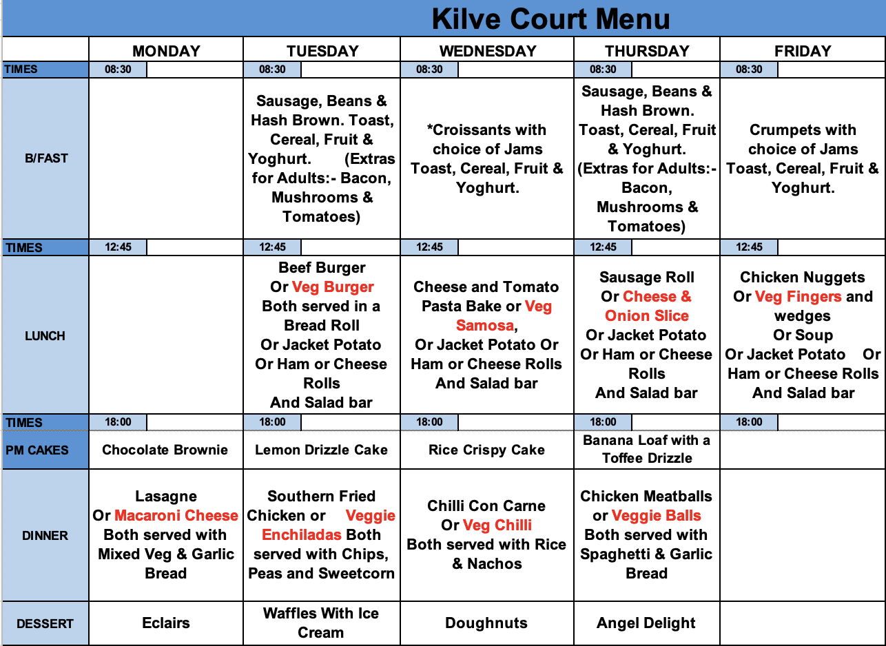
The most important one…Food
Firstly there is loads of it.
There is always a variety and they are very accommodating if anyone has particular likes or dislikes with meals coming up.
The children order their food the meal before so changes can be made if needed.

Slide 23
Kit List and medication
Please make sure you have collected a kit list and EV5 form.
We aren’t able to provide any medication that is not stated on the form before we leave (this includes paracetamol and antihistamine). We understand that medication can be needed closer to the date but if the information changes closer to the date please let us know.
Kit list does state that no electronics are allowed (books and card games are encouraged) – mostly it is an opportunity for them all to be away and enjoy some different and fun activities with their friends but most importantly it is a safeguarding issue for both Kilve and us as a school. Cameras and phones in rooms where people will be changing is obviously a concern. Kilve have a no phones policy and will expect children who bring them to be collected.
School will provide a number for 24 hour contact closer to the time in case of emergency and we will have all your contact details if we need to contact you.

Slide 24
Other important information
We are meeting with secondary schools over the coming weeks – if there is information you would like us to know or pass on specifically then please let us know or email the class email.
Dates for important events across the summer can be found on the class page on the website – if you know you can’t make any activity or do not want your child involved then please let us know as soon as possible.
Letters for hoodies came home today.

