Slide 1



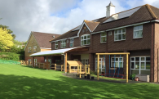
Welcome to Trull Church of England VA Primary School

Slide 2
Dear Parents,
Thank you so much for taking the time to look at our starting school page. We hope this PowerPoint will provide you with some useful information before your child starts school. We are looking forward to speaking to you over the next few weeks and meeting you and your child in September.
If you have any further questions, please do not hesitate to contact the school via phone (01823 333239) or email.

Slide 3
Please return all consent forms to the school office or via email by 24th June.
Starting School Pack
You will receive a starting school pack in the post. The pack should contain the following information:
Main induction letter
Welcome to the Foundation Stage at Trull School (Starting school booklet)
Data Collection details form
Induction Booklet with Consent Form
Tapestry information/consent form
Universal Infant Free School Meals & Pupil Premium leaflet
School dinners information
Term dates 2022/2023
Free and subsidised milk information
Early and Late club
Parents’ Guide to the Early Years Foundation Stage Framework
Trull School Fundraisers information sheet

Slide 4



Our Induction Process
June/July We will visit your child’s pre schools before the end of this term. Please sign your child up for one story session and one stay & play session.
Please visit our starting school page on our website which will be updated over the coming months.
Tapestry Before the summer holidays you will receive an activation link from Tapestry. (Please remember to check your spam folder.)
September You will book an appointment time on SCOPay to meet with us. This will be an opportunity for us to chat to you and your child. Your child will be shown their peg and can have a look around the classroom. End of September Our EYFS Curriculum Meeting (All parents welcome).

Slide 5
EYFS
Week 1 01.09.22 Thurs- Parent Meetings Fri- Parents Meetings
Week 2 Beginning: 05.09.22 Children in Part Time 8.50am to 1.30pm (including lunch)
Week 3 Beginning: 12.09.22 Children in Full Time 8.50am to 3.10pm TEC and TLC available to book
However, if you feel that your child is not coping with full days, we are happy to discuss further part time days if necessary.

Slide 6
September
Your child will experience new routines, new adults, new expectations, and they will be learning in a different environment. Therefore, they may be very tired at the end of each day.

Slide 7
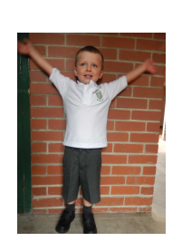
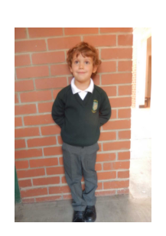
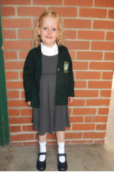
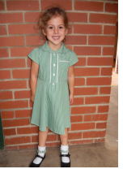
School Uniform
Summer Uniform | Winter Uniform

Slide 8

Uniform
White polo shirt (not button shirts and ties).
Green, black, green, grey or white tights/ white socks (also white socks/tights in the Summer)
PE kits - please name Tshirt/shorts/daps/PE jumper.
Shoes- Preferably with a velcro strap so your child can take them on and off independently.
A waterproof zip-up coat.
Please name all clothing!
Items of clothing that are labelled are likely to be found!
Uniforms can be purchased at Taunton uniforms in East Street.
Independence
We really like to encourage independence when getting ready.
Please encourage your child to practise dressing and undressing over the holidays. Please also practise putting on PE kit, particularly daps!

Slide 9
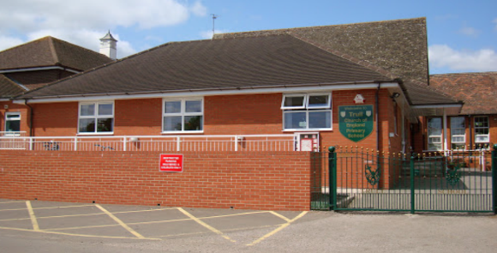
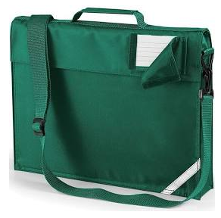




The First Day
The school gates open at 8:35am.
The classroom door will open at 8.40am. Parents are asked to say goodbye at the classroom door.
End of day – the classroom door opens at 3:10pm.
What will my child need to bring?
Book bag (with green strap). Please label and personalise with a small key ring.
A morning snack (fruit/ veg) in a small, named pot.
A named water bottle.
If you would like your child to have milk, please fill in the online order form.

Slide 10




Lunch
Sign up for free school meals and choose menu online (email will be sent when bookings are open).
If your child will be having a packed lunch, please make sure that it is clearly labelled.
Please let them practise using their lunch box, including opening any little pots/containers within.
Include any cutlery if needed.
We are a healthy school – no sweets please. However a chocolate covered biscuit/wafer is allowed.
Our school has a strict no nuts policy.
Please stick to food that they like eating (no surprises!). They may not eat as much as they usually do to start with, which is quite normal.

Slide 11
What does learning in EYFS look like?

Slide 12
Mention key changes to the new curriculum
The Early Years Foundation Stage Curriculum
Prime Areas
Communication & Language | Listening, Attention & understanding
Personal, Social& emotional development | Self-regulation
 | Managing self
 | Building relationships
Physical Development | Gross Motor Skills
 | Fine Motor Skills
Specific Areas
Literacy | Comprehension
 | Word Reading
 | Writing
Mathematics | Number
 | Numerical patterns
Understanding of the World | Past and Present
 | People Culture and Communities
 | The Natural World
Expressive Arts and Design | Creating with materials
 | Being Imaginative and Expressive
The prime areas are very important because they lay the foundations for children’s success in all other areas of learning and of life.
All parents will be invited to our EYFS curriculum meeting that will take place early in the Autumn Term.

Slide 13

Preparing for school
See our starting school booklet for things that you can do to prepare your child for school
Please do not worry if your child cannot do all these things, it is just a general guideline/expectation.

Slide 14

School readiness - YouTube: https://www.youtube.com/watch?v=F-LYT_icFBI

Slide 15

https://hungrylittleminds.campaign.gov.uk/

Slide 16


The following website is a useful resource to look at: www.foundationyears.org.uk
‘What to expect, when?’
(You can find this on our starting school page)

Slide 17
Induction pack
Please read through all of the documents in your induction pack and return all of the signed forms by 24th June.

Slide 18


Please remember to visit our school website and look at our
Starting school page as it will continue to be updated over the coming months.

Slide 19





And lastly….
Thank you for choosing Trull!
We are looking forward to meeting you and your child in person over the coming months.
We hope you have found this PowerPoint helpful.
If you have any further questions please to do not hesitate to contact the school via phone or email.

