Slide 1
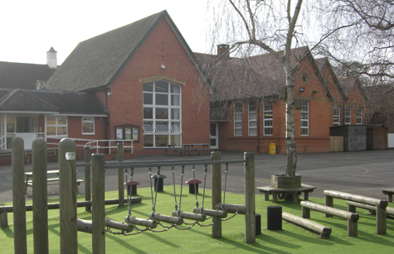
Phonics at Trull Church of England VA Primary School

Slide 2
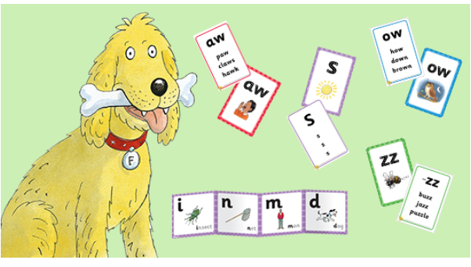
Phonics at Trull School
Our programme for teaching phonics is Floppy’s Phonics.
Floppy’s Phonics is a rigorous, easy-to-use systematic synthetic phonics teaching programme for early reading and writing success.

Slide 3
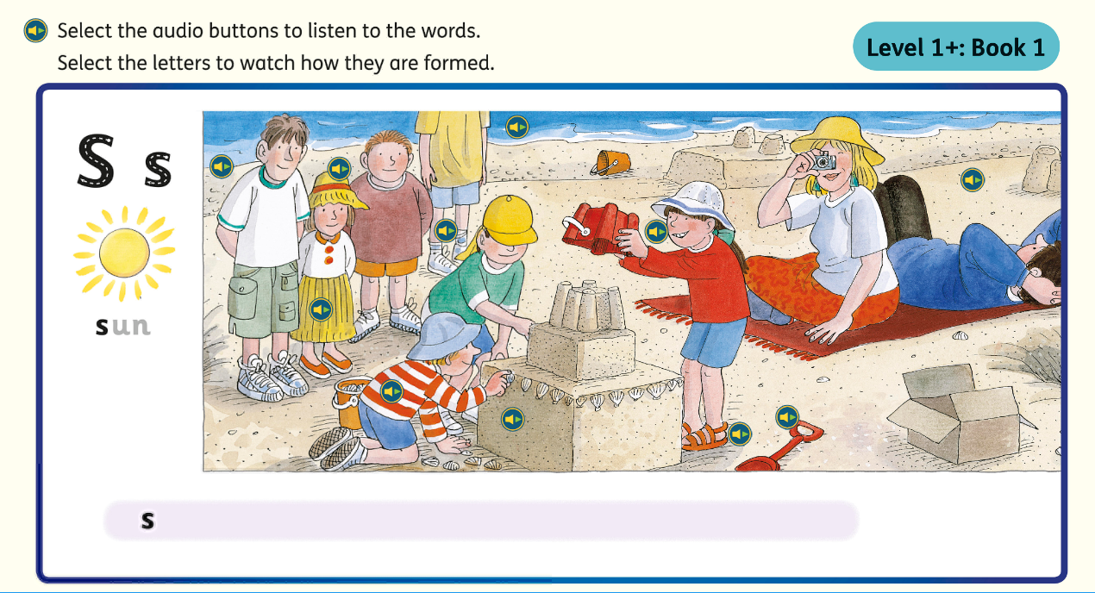
We use the interactive phonics lessons and activities to teach sounds, blending, grapheme-phoneme correspondences, letter formation and pronunciation to the whole class or for individual practice. Planning guidance and assessment materials enable consistent teaching and careful monitoring of children’s progress.
Each phoneme is introduced with a song and a picture involving the well-loved Oxford Reading Tree family.
There are follow-up activities and books to practise and consolidate new learning each week. All our phonics reading books are fully decodable.

Slide 4
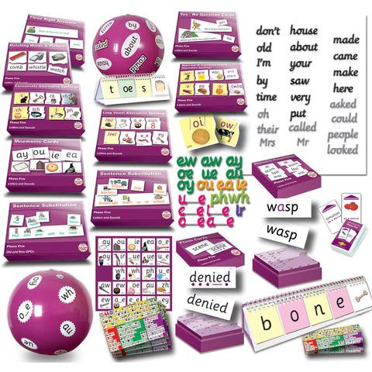
Phonics Lessons
The moment children begin their Reception year they are immersed in a language rich environment, with stories, rhymes, music and songs. These are all crucial for developing speaking and listening, prior to reading. Phonics lessons are taught discretely in Reception and Key Stage 1 and follow a clear and consistent model. During Year 2 the emphasis changes to investigating spelling rules and learning to use dictionaries. At all stages our highly skilled team strives to deliver phonics lessons in an engaging and interactive manner and skills are practised with games and engaging activities.

Slide 5
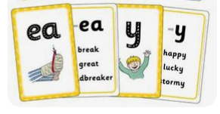
Parental Involvement
Teachers meet with parents to explain how reading is taught and the terms that are used. Once the children begin to learn their first grapheme-phoneme correspondences, they are encouraged to practise at home using phoneme mats, decodable reading books (matched carefully to their stage) and homework activities.

Slide 6
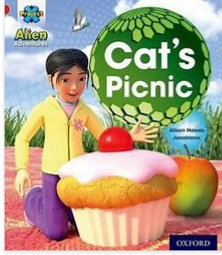
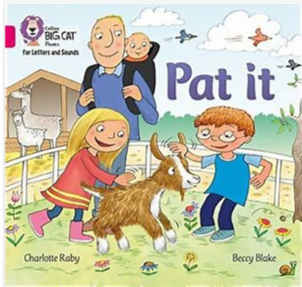
Phonetically Decodable Reading Books
We have many ‘synthetic phonics’ reading scheme books for Foundation Stage and Key Stage 1, which are in line with the national curriculum objectives and exciting and stimulating for the children. We also subscribe to Oxford Ow online phonic books so that the children are able to practise their reading when learning from home.

Slide 7
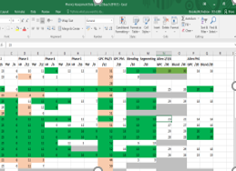
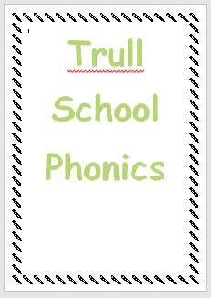
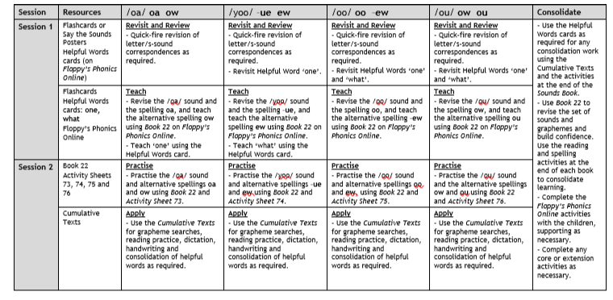
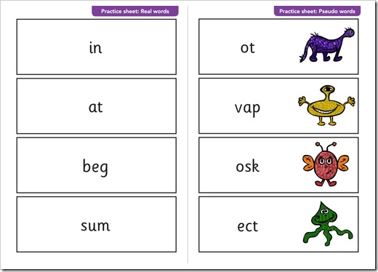
Assessment and Training
All groups from Foundation Stage up to Year 2 are monitored and reviewed regularly. Extra support is put in place, where needed. Training is also given to all TAs and new teachers to ensure a consistent, high quality approach.

Slide 8
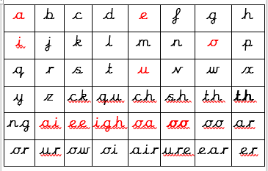
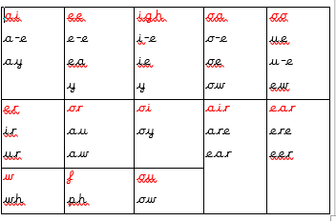
Application of Phonics
Phonics is fundamental. Whenever they are writing (across the curriculum ), as soon as the children have been introduced to alternative graphemes, the expectation is that they apply these rules, with the help of a phoneme mat. Our aim is for the children to leave Key Stage 1 fluent readers, with the skills to blend in order decode unknown words and the confidence to segment words in order to attempt more difficult spellings as they move into Key Stage 2.

Slide 9
How can you help at home ?
Correct pronunciation https://www.lesleyclarkesyntheticphonics.co.uk/index.php/parents/125-articulation-of-phonemes
Correct vocabulary
It is really helpful if we use the same language at home and at school.
Little and often is the key.
Make it fun!

Slide 10
Phoneme
A phoneme is the smallest unit of sound in a word.
There are 44 phonemes .
Grapheme
A letter or letters that represent a phoneme
e.g.
c ai igh
Children need to practise recognising the grapheme and saying the phoneme that it represents (and vice versa!)

Slide 11
The 44 phonemes
/b/ | /d/ | /f/ | /g/ | /h/ | /j/ | /k/ | /l/ | /m/ | /n/ | /ng/
/p/ | /r/ | /s/ | /t/ | /v/ | /w/ | /y/ | /z/ | /th/ | /th/ | /ch/
/sh/ | /zh/ | /a/ | /e/ | /i/ | /o/ | /u/ | /ae/ | /ee/ | /ie/ | /oe/
/ue/ | /oo/ | /ar/ | /ur/ | /au/ | /er/ | /ow/ | /oi/ | /air/ | /ear/ | /ure/

Slide 12
Blending
Recognising the letter sounds in a written word, for example
c-u-p
and merging or ‘blending’ them in the order in which they are written to read the word ‘cup’
Segmenting
‘Chopping Up’ the word to spell it out
The opposite of blending
Use ‘sound talk’ or ‘robot speak’

Slide 13
We move on from single letters to...
Digraphs – 2 letters that make 1 sound
ch th ng oa ai
Trigraphs – 3 letters that make 1 sound
igh air

Slide 14
Tricky Words
Words that are not phonetically decodable
e.g. was, the, I
Some are ‘tricky’ to start with but will become decodable once we have learned ‘alternative’ graphemes in ‘Phase 5’
e.g. out, like,

Slide 15
Phase 5 phonics
The children will learn new graphemes to represent phonemes they already know.
For example, the phoneme ‘ee’ can be represented in many different ways.
Split digraphs
a-e came e-e Steve
i-e kite o-e poke
u-e tune

