Slide 1
Year 6 Residential visit 2024 Charterhouse 15th, 16th, 17th July

Slide 2
Where are we going?

Slide 3
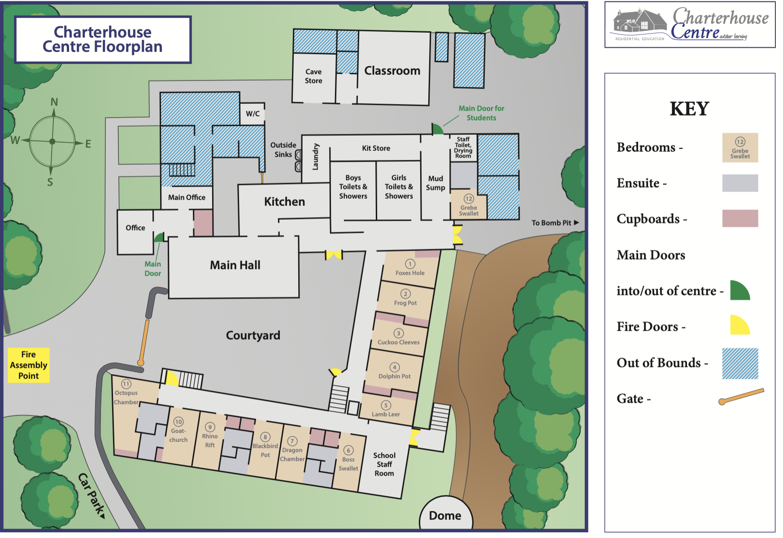
Charterhouse Residential Centre - Owned by the Somerset CC - In an area of Outstanding Natural Beauty - Sole occupancy

Slide 4
Our aims...
Build confidence
Build teamwork skills
Take personal challenges
Take some risks – different for different children

Slide 5
Video link on their website

Slide 6
Our days...
Activities:
Archery, caving, climbing, low ropes, team building games, orienteering
Evening activities – wild games, disco

Slide 7
Food! 3 hot meals a day (Packed lunch on first day please)

Slide 8
Food!
All diets catered for and always a vegetarian option
Children will be encouraged to try food but will not be forced to eat anything that they don’t want to
Hot options at all meals
We are the only school on site:
Breakfast 7:30 - 8.30
Lunch – 12:00 - 12.45
Evening meal – 18.00 – 19:00

Slide 9
Bedrooms Rooms of 6 with one, 8 most have ensuites

Slide 10
Accommodation: Indoors Bunk beds Most rooms are en suite Toilets and shower rooms close by if not

Slide 11
Things to remember: CHECK the Kit list! Plenty of old clothes Nothing precious Try to pack together to make sure they know what is theirs Bin bag for wet stuff is essential No electronic devices– small card games and notepads encouraged Some find a clock useful to have in their room but not essential

Slide 12
Things to remember: 1) Bedding – sleeping bag and pillow 2) Weather – all possibilities though hopefully sunny 3) No gadgets or money 4) Packed lunch for day 1 in disposable wrappings please 5) Refillable water bottle, named please 6) Sweets.... (one small bag)

Slide 13
Medication All needs to be labelled with child’s name and dose and timings And appear on the medical form handed in beforehand Needs to be given to us on the day Calpol just in case is fine! Please let us know any common issues that could occur overnight

Slide 14
Any questions? Class email is always open if you think of anything. Make sure you take a kit list and a medical form Medical to be returned by the 1st July please

Slide 15
Other dates of importance: Sports Day 27th June – back up 5th July Transition Days 2nd and 3rd July Wizard of Oz performance 10th and 11th July 6pm start Reports and SATs results out 12th July Leavers Service 24th July 2pm start

