Slide 1
Welcome to Yew Class
2024-2025

Slide 2
Teaching Staff
Mr Bond
Mrs Andrews
Mrs Cockings
Mrs Mitchell
Mr Adams

Slide 3
Timetable

Slide 4
Routines
Homework
5 CGP Homework Books in on a Thursday at the latest and back out on a Friday (if help is given, please put an S in the top corner)
Guided Reading Questions in on a Wednesday
Spellings, tested on a Monday – new ones out on a Monday and can be practiced on paper or on spelling shed.
PE Kit (needed for a Monday and Friday – yellow school t-shirt, green jumper, black tracksuit bottoms, black shorts/skirt and trainers).
Forest school this half term on Wednesday, starting on 18/9/24.
Things to bring into class – water bottles and snack pots. Children are more than welcome to bring pencil cases from home, we do have everything they will need, so you don’t need to provide anything.
School Website has all the information for homework and upcoming events.

Slide 5
Reading
This year we are trying a new initiative within reading higher up the school.
Hopefully all your children have brought home their reading book with a book mark in it.
They have a new book mark for every new book they read and they record the date and pages on it.
We are hoping this will make it easier for the children themselves to record what they have read and us to check through.

Slide 6
Dates
SATs and Residential meeting: April 2025
Bikeability 3 groups: 9th/10th, 14th/15th, 21st/22nd October (adult helpers required for the course to run)
KS2 Test Week: 12th May (All one week)
Transition Days: 1st and 2nd July
Year 6 performance: 25th and 26th June
Residential: 7th – 9th July
Leavers Service: 23rd July

Slide 7
Residential
Kilve Court – first time for all of us.
Outdoor activities – they have the potential for water based activities as well as climbing, cycling and high ropes.
https://sseoutdoors.co.uk/centres/kilve-court/

Slide 8
KS2 Test Week
12th May
No Writing or Science paper.
English spelling test.
English grammar and punctuation test.
English reading.
Mathematics (3 papers – arithmetic, reasoning 1 and reasoning 2).
Teacher Assessment for writing

Slide 9
KS2 Test Information
Children will receive 3 scores:
Working at National Expectation – Yes/No.
Scaled Score – 100 is expected.
Raw Score

Slide 10
What can you do?
Reading - this is the most important thing you can do
Times Tables – through ttrockstars
Spelling – regular engagement in their spellings
Interact with them about Homework
Check the website - https://www.trullprimary.com/yew-12/
Internet Sites – MyMaths, BBC Bitesize, etc.
Talk to them about their learning

Slide 11
Online Safety information
Using the TEAM approach can help to keep children safe.

Slide 12
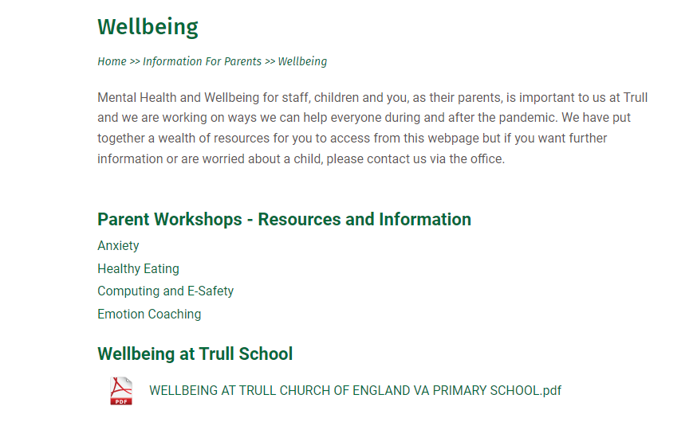
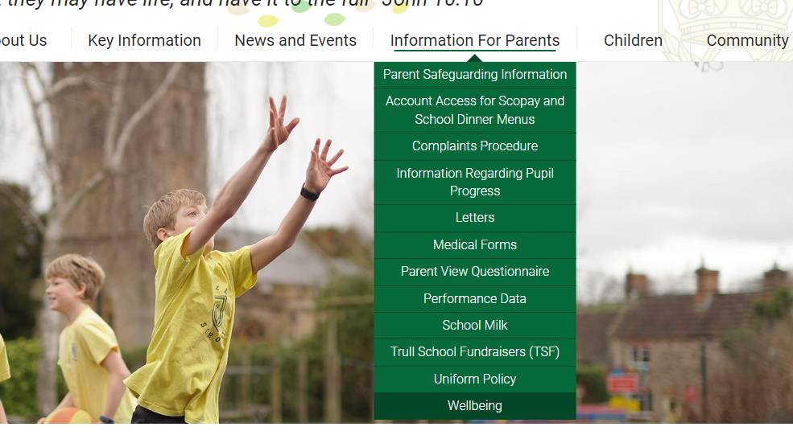
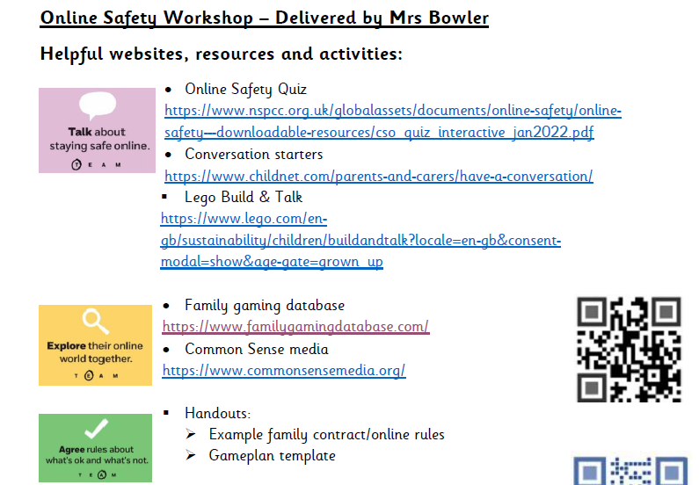
Please visit our school website to find helpful resources to support you with online safety at home: https://www.trullprimary.com/
Click on the Wellbeing page to find the resources

Slide 13
Any Questions?
If you have any questions throughout please use the school or class email, come and see me on the door or ring the school office and they or I will get back to you.
Class email address: Yew.Class@trullschool.co.uk

