Slide 1
Welcome to Yew Class
2023-2024

Slide 2
Teaching Staff
Mr Bond
Mrs Andrews
Mrs Mitchell
Mr Adams

Slide 3
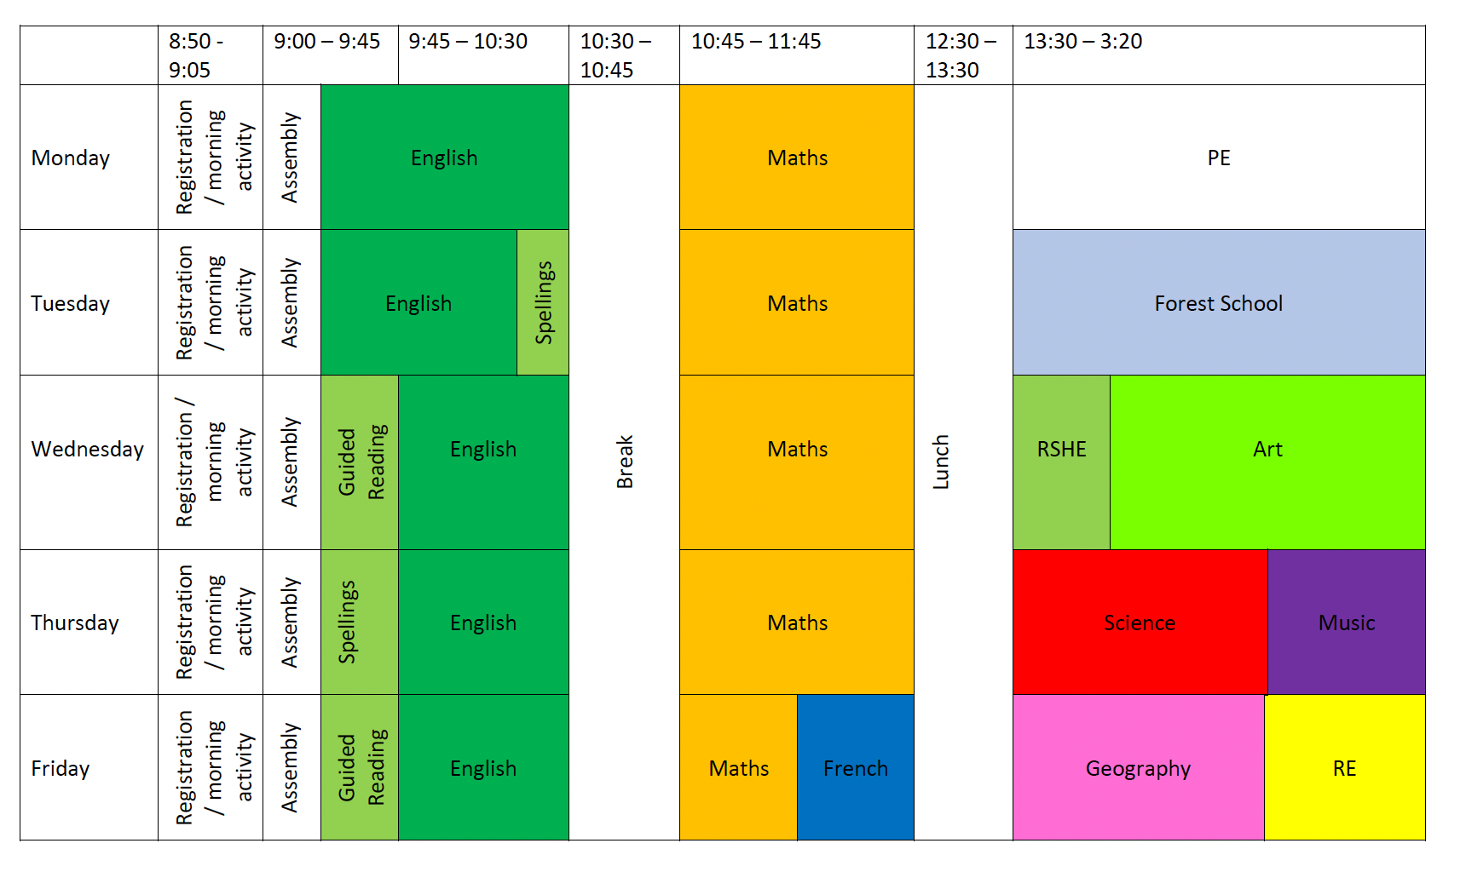
Timetable

Slide 4
Routines
Homework
  5 CGP Homework Books (if help is given, please put an S in the top corner)
  Guided Reading
  Spelling Shed
PE Kit (needed for a Monday – yellow school t-shirt, green jumper, black tracksuit bottoms, black shorts/skirt and trainers). This is to be worn into school every Monday.
Forest school this half term on Tuesday.
Things to bring into class – water bottles and snack pots. They are more than welcome to bring pencil cases from home, we do have everything they will need, so you don’t need to provide anything.
School Website has all the information for homework and upcoming events.

Slide 5
Dates
SATs and Residential meeting: March 2021
KS2 Test Week: 13th May (All one week)
Transition Days: 2nd and 3rd July
Year 6 performance: 10th and 11th July
Residential: 15th – 17th July
Leavers Service: 24th July

Slide 6
Residential
Charter House – went last year
Outdoor activities – last year they did caving, low ropes, archery, climbing.
https://sseoutdoors.co.uk/centres/the-charterhouse-centre/

Slide 7
KS2 Test Week
13th May
No Writing or Science paper.
English spelling test.
English grammar and punctuation test.
English reading.
Mathematics (3 papers – arithmetic, reasoning 1 and reasoning 2).
Teacher Assessment for writing

Slide 8
KS2 Test Information
Children will receive 3 scores:
  Working at National Expectation – Yes/No.
  Scaled Score – 100 is expected.
  Raw Score

Slide 9
What can you do?
Reading - this is the most important thing you can do
Times Tables – through ttrockstars
Spelling Shed – regular engagement in their spellings
Interact with them about Homework
Check the website
Internet Sites – MyMaths, BBC Bitesize, etc.
Talk to them about their learning
Share your expertise

Slide 10
Any Questions?
If you have any questions throughout please use the school or class email, come and see me on the door or ring the school office and they or I will get back to you.
Class email address: Yew.Class@trullschool.co.uk

